Slide 1
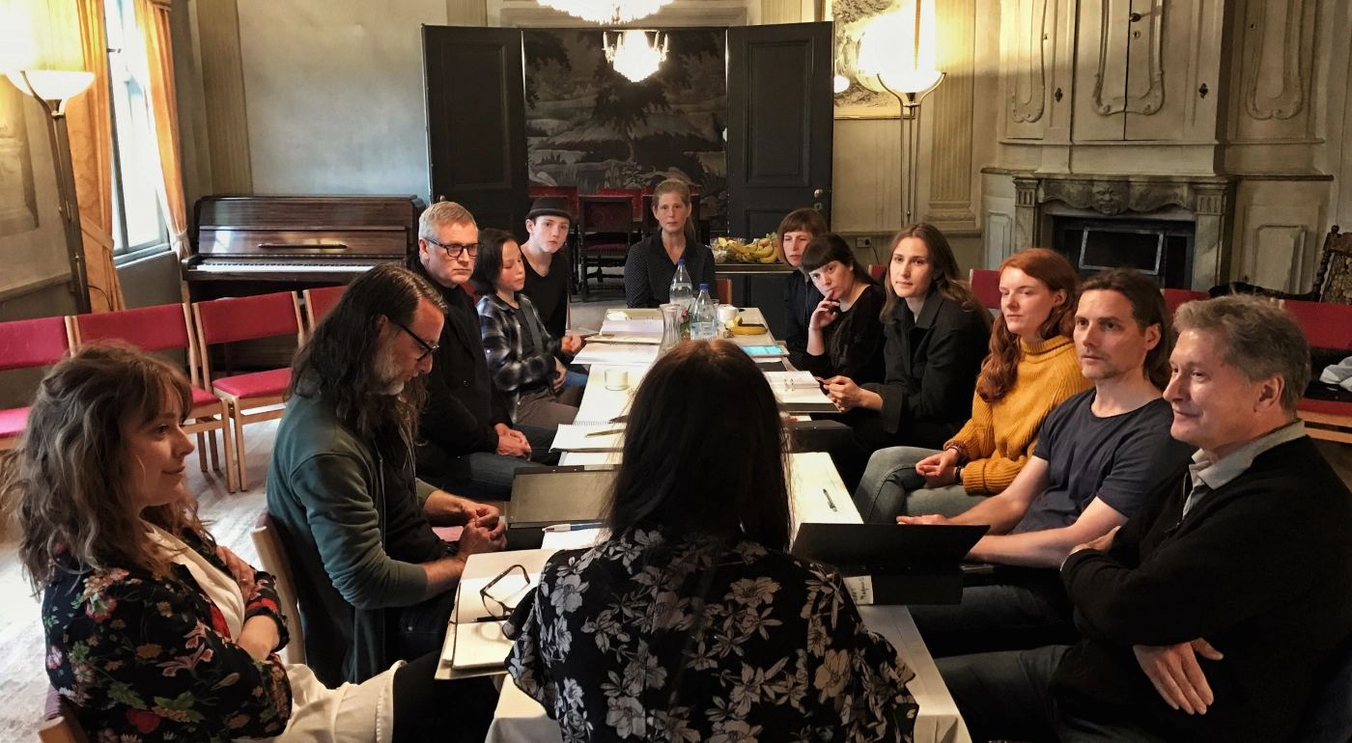
Designing Spaces for Collaboration
Jonas Nordquist, PhD
Associate Residency Director, Karolinska University Hospital / Karolinska Institutet, Sweden
Senior Fellow (hon), School of Medicine, Dentistry and Health Sciences, University of Melbourne, Australia

Slide 2
- Memory, experience, aligning
- Discuss collaboration from a political perspective and how this could impacts design

Slide 3
Collaboration
Coordination

Slide 4
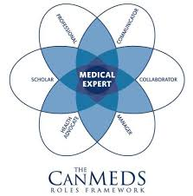

Slide 5
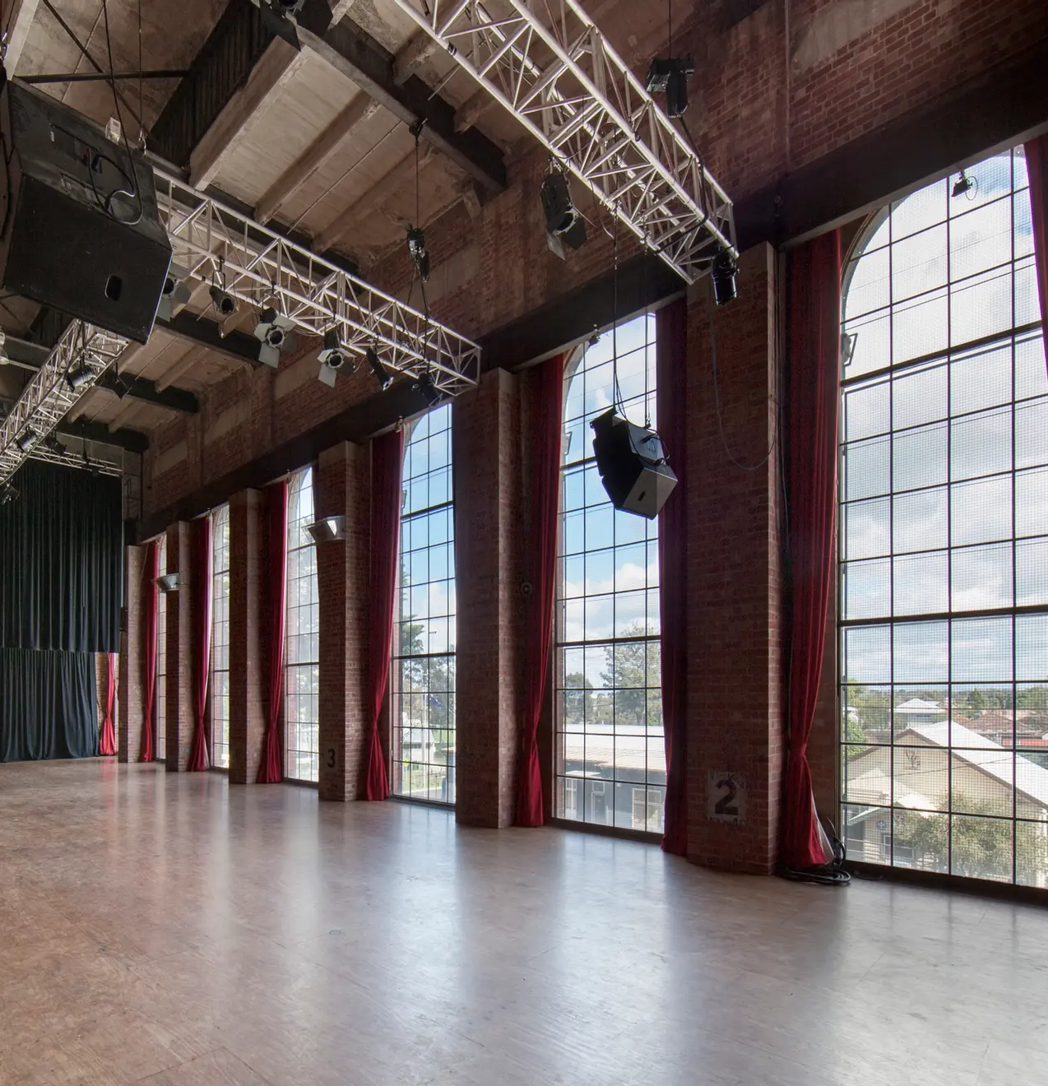
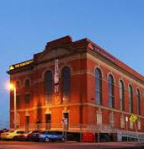

Slide 6
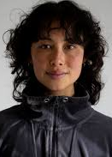
Lilian Steiner Australian choreographer, dancer and performer

Slide 7
Sign systems in performing arts
Text
Scenography
Choreography
Costume / mask
Light
Sound / music
Objects
Acting style

Slide 8

Coordination / collaboration?
Onset of symptoms
Diagnostic workup
Differential dignosis -> Diagnosis
Therapy regims
Side effects?
Full recovery – partial recovery – palliative stage

Slide 9
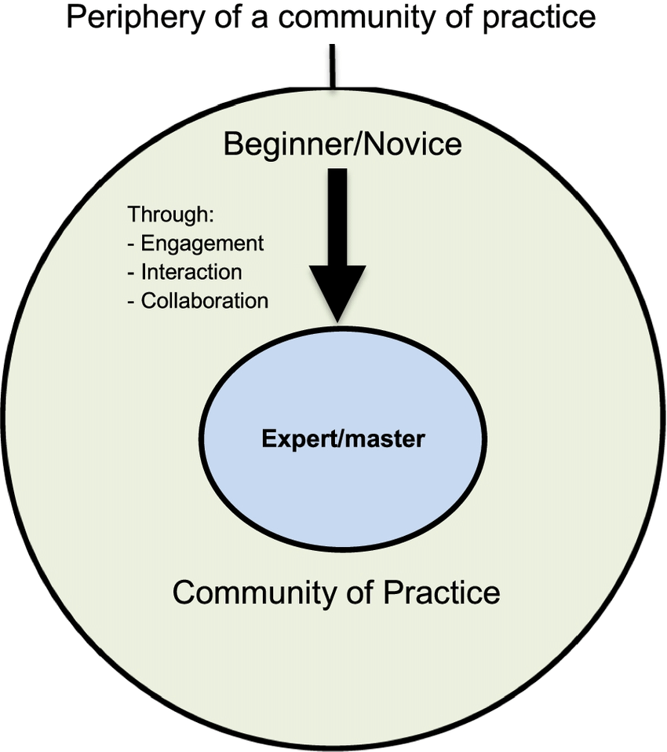
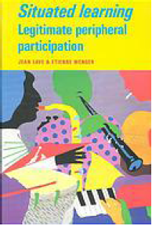

Slide 10
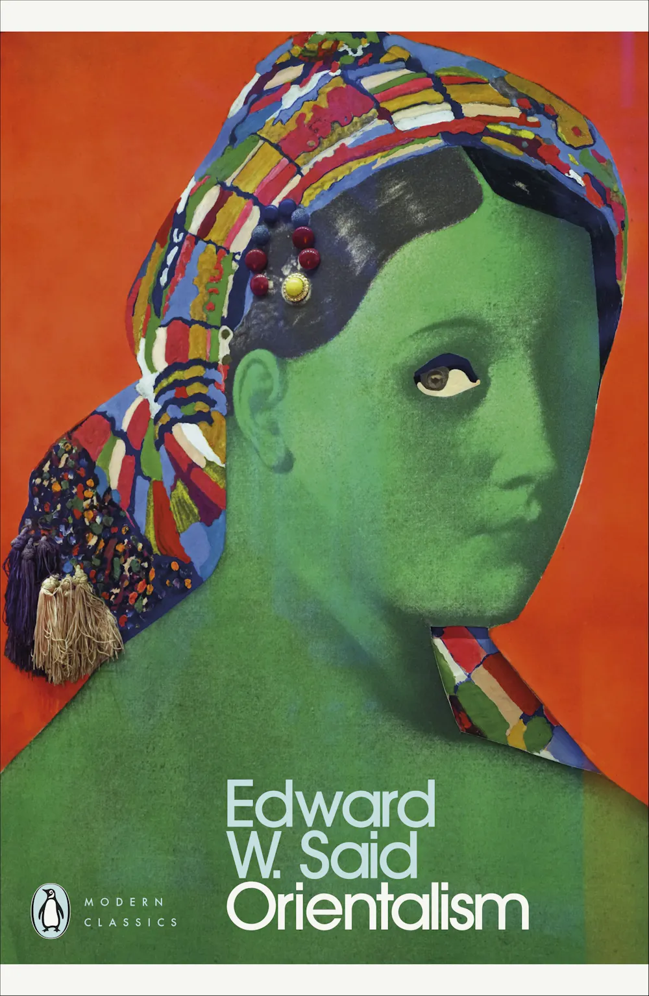
Dominant Cultures needs to create “the others” to self-define

Slide 11

Erving Goffman’s
Front stage and Backstage
Portray a role
Socialization

Slide 12
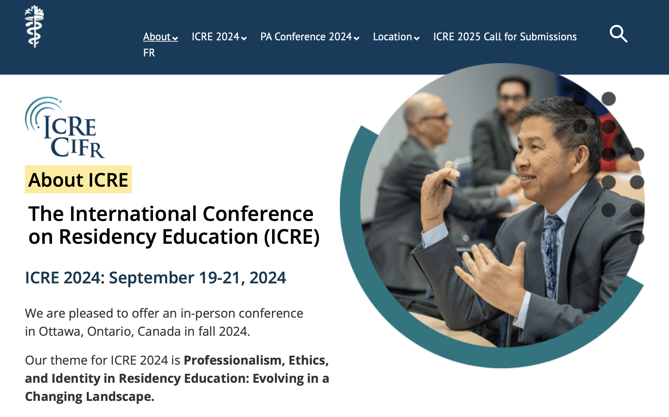

Slide 13


Slide 14
Power
Decision-making power
(open conflict or tension)
Non-decision-making power (agenda setting)
Ideological power (“language, metaphors, examples”)

Slide 15
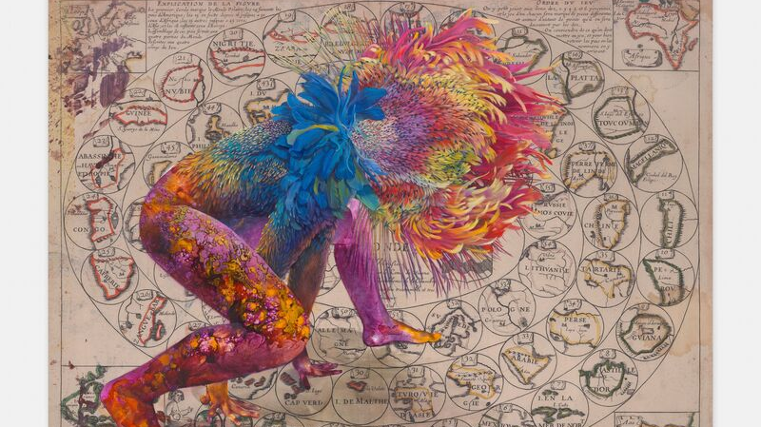
Firelei, Báez

Slide 16
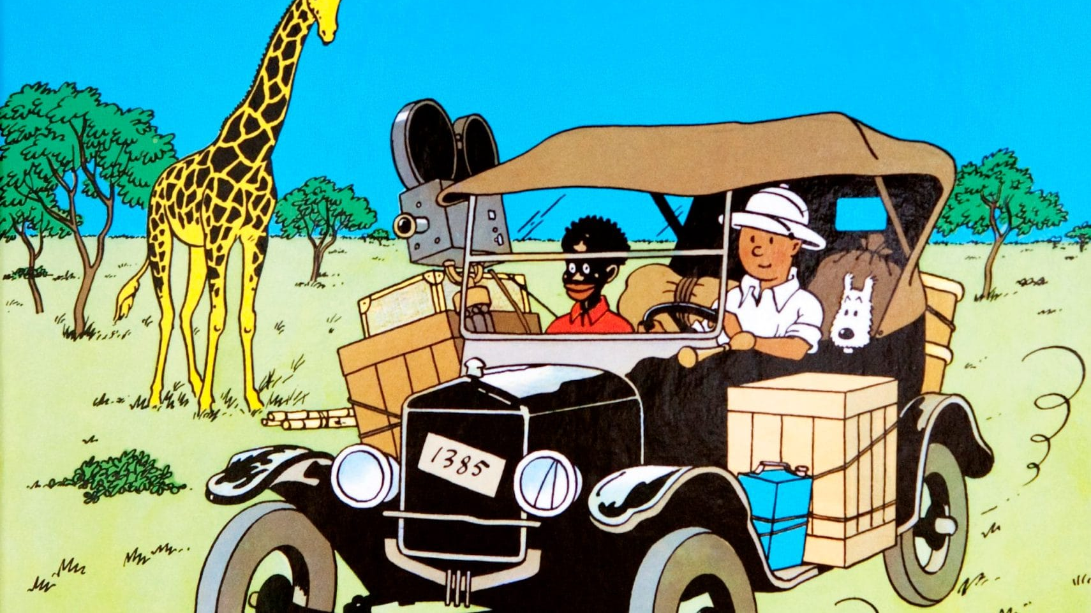

Slide 17

Race, class, gender, and other individual characteristics “intersect” with one another

Slide 18
Nordquist & Philibert:
“The physical LE for IPE benefits from efforts to change “dedicated” spaces to shared areas to reduce professional segregation and facilitate engagement. This is particularly important for informal spaces where interaction and socialization occurs.”

Slide 19
Past and Present

Slide 20
Urban landscape
Campus
Building
Room

Slide 21
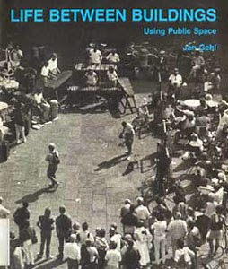
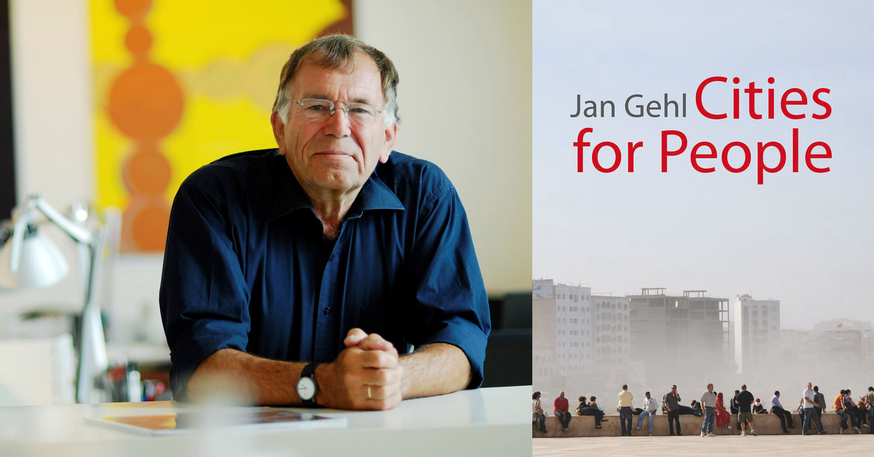

Slide 22
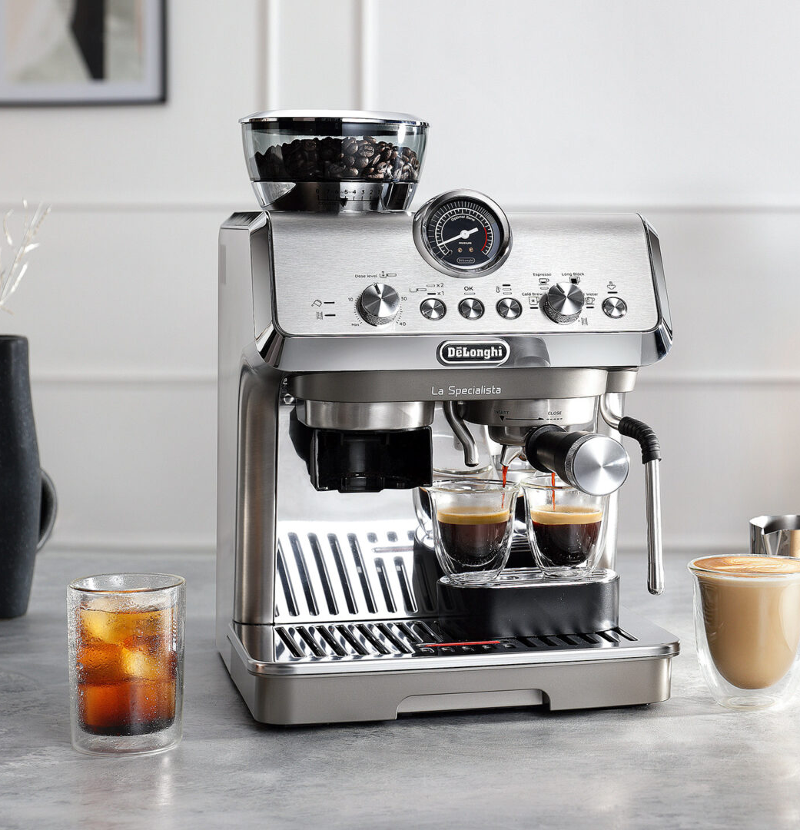
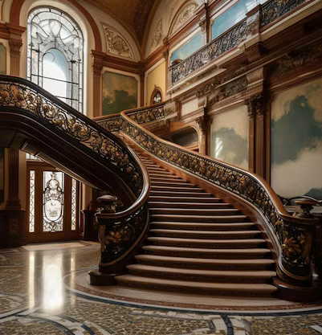

Slide 23
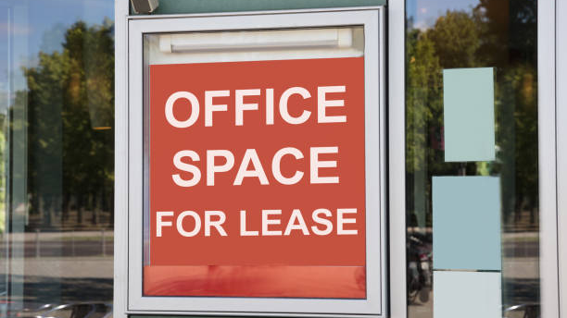

Slide 24
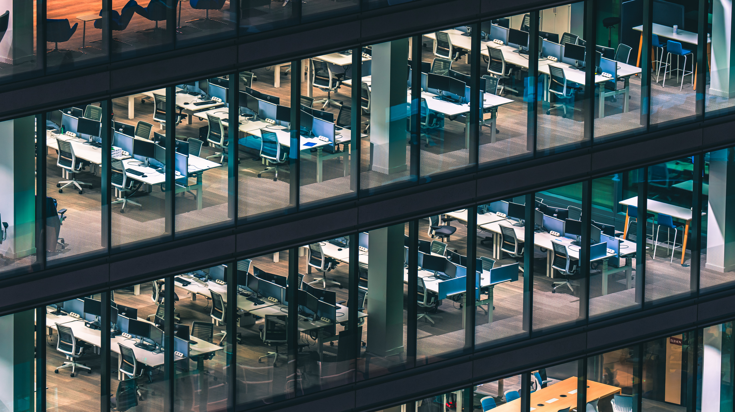

Slide 25
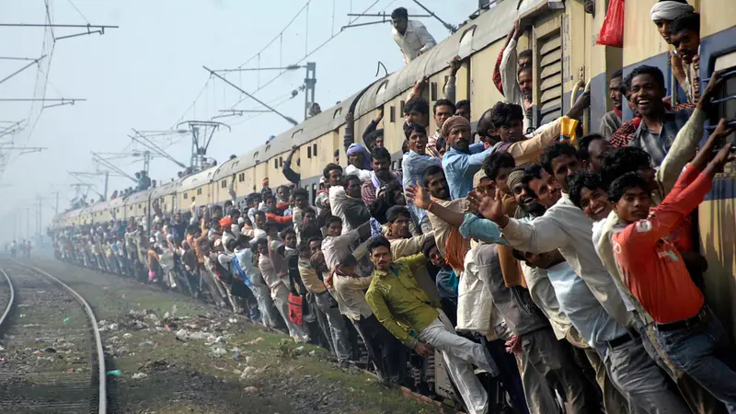

Slide 26
Space, Place and Experience

Slide 27
Money, money, money
Must be funny
In the rich man's world
Money, money, money
Always sunny
In the rich man's world

Slide 28
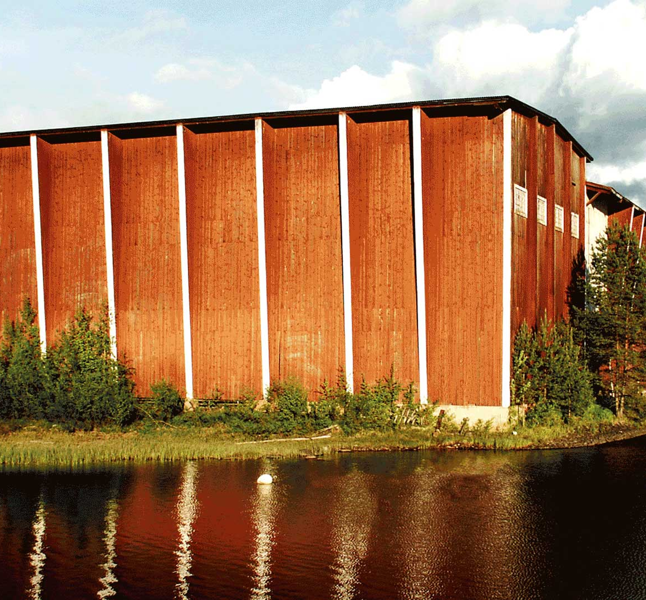
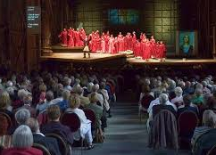
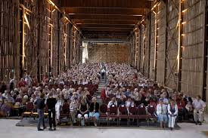
Operan på skäret, Sweden

Slide 29
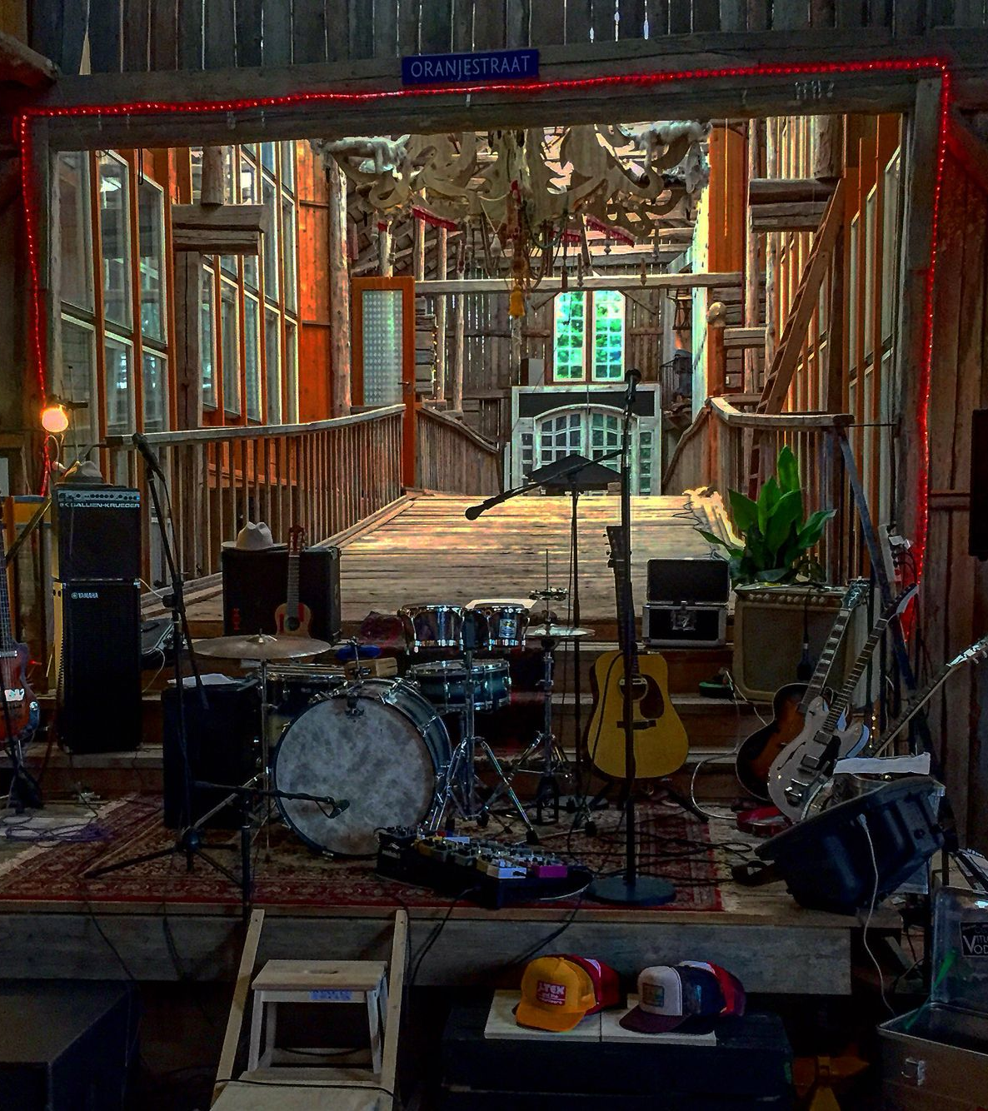
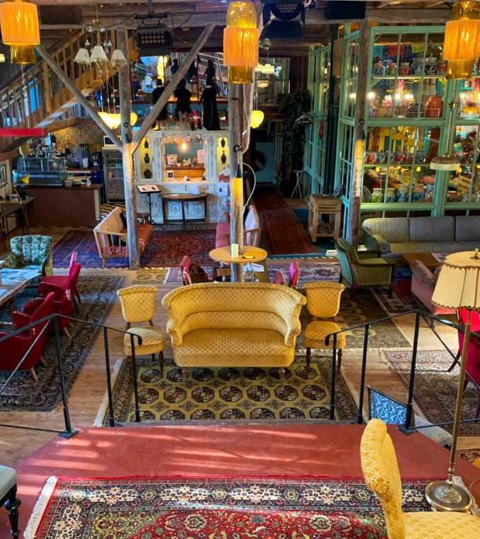
Alma Löv Museum of Unexp. Art, Sweden

Slide 30
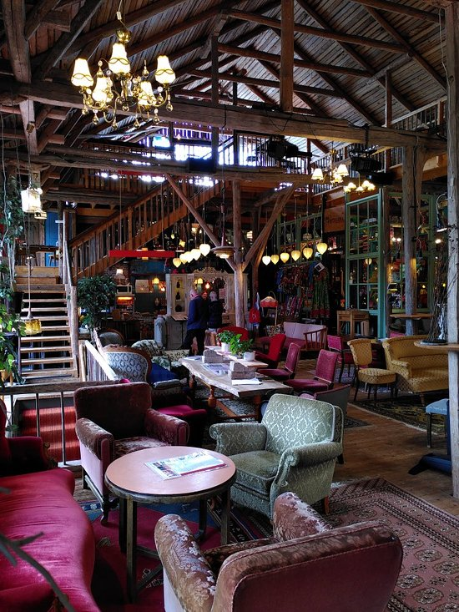

Slide 31
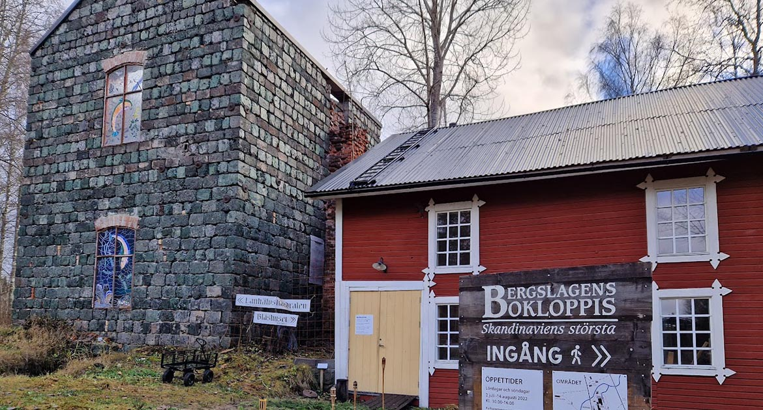
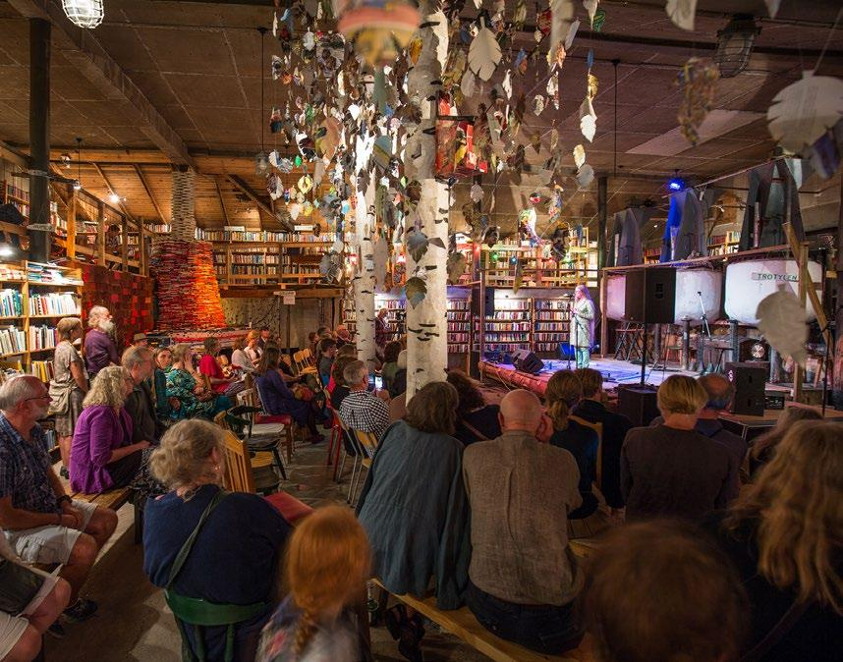
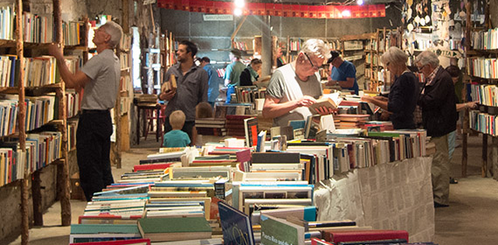

Slide 32
Performativity

Slide 33
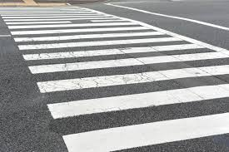

Slide 34
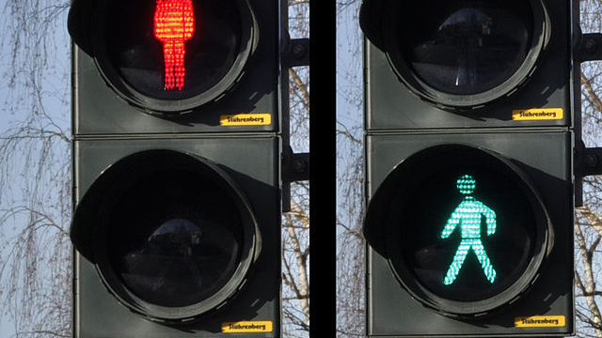

Slide 35
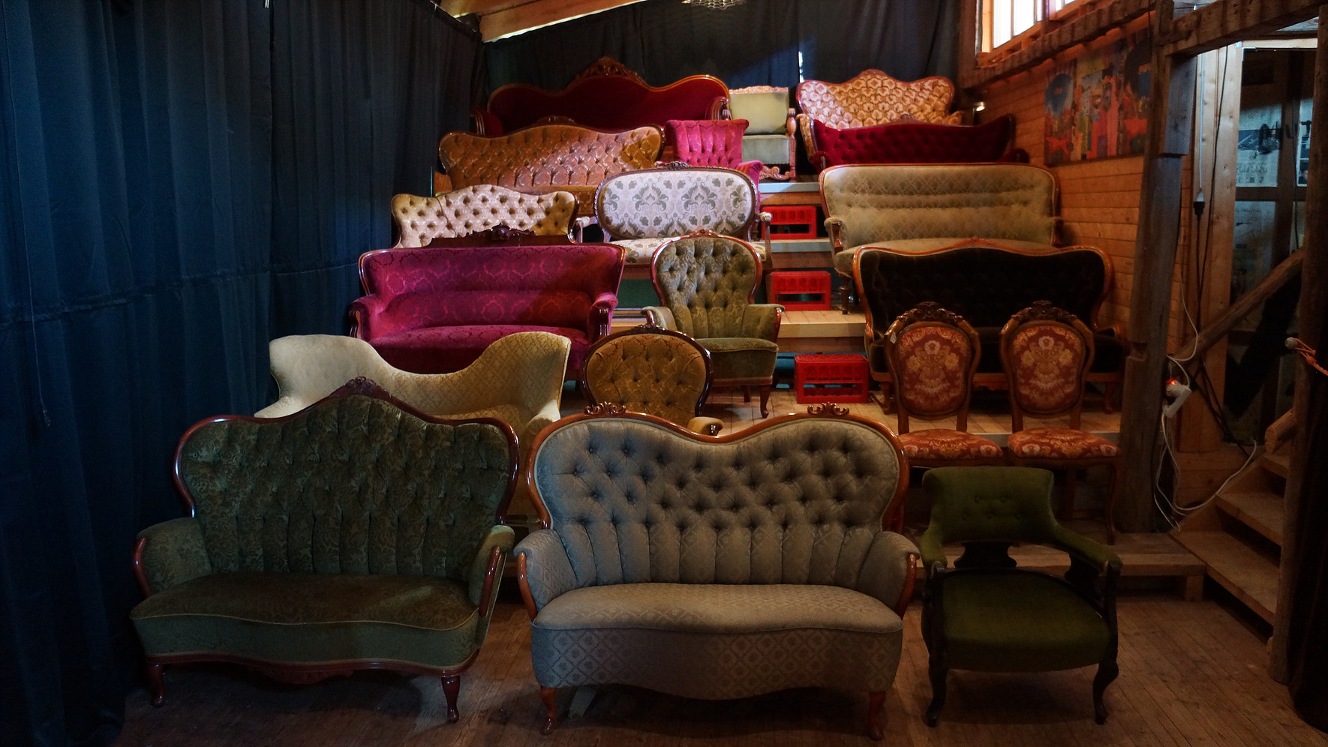
Alma Löv Museum of Unexp. Art, Sweden

Slide 36
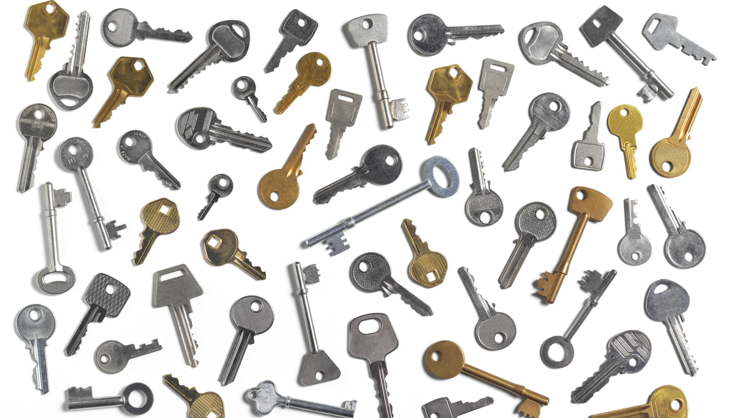
Some key aspects of experience

Slide 37
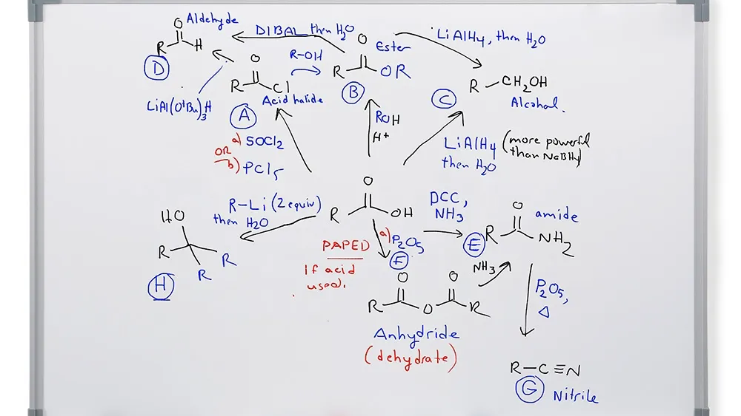

Slide 38
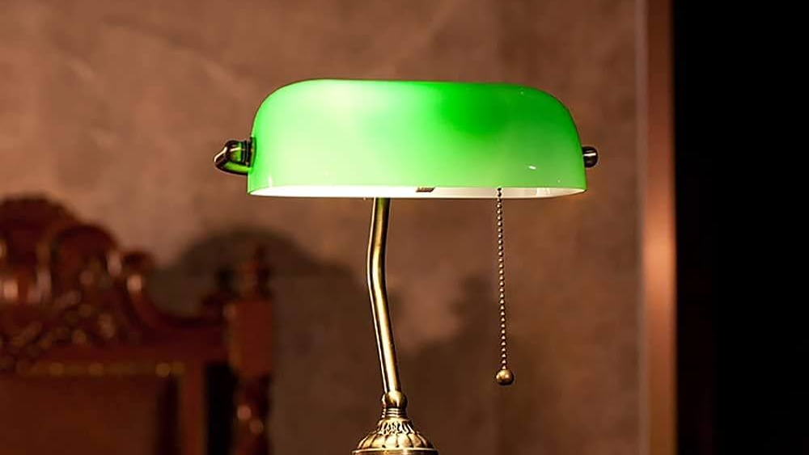

Slide 39
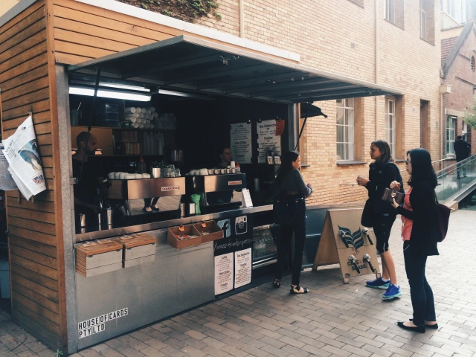

Slide 40
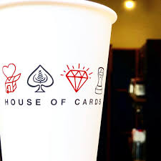

Slide 41
My contribution for further conversations today:

Slide 43
Sign systems in performing arts
Text
Scenography
Choreography
Costume / mask
Light
Sound / music
Objects
Acting style

Slide 44
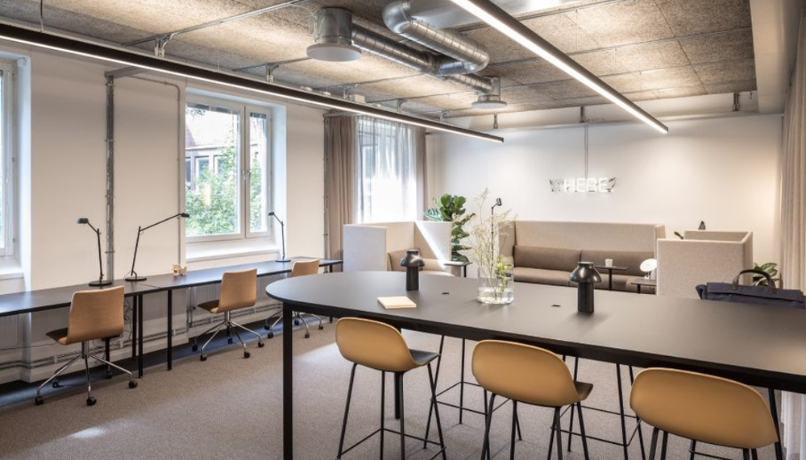

Slide 45
Designing Spaces for Collaboration?

