Slide 1

From Influence to Confluence
Harnessing the Power of Diverse Perspectives in Teams
Chyonne Kreltszheim
11 September 2024
0414 785 619

Slide 2
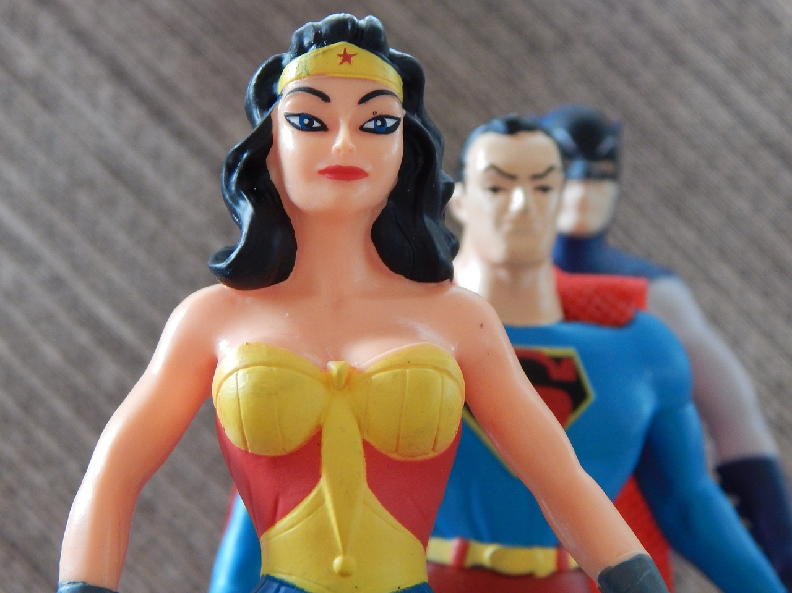
If you could have one superpower, what would it be?
If you could have just one superpower…
…what would it be?
[Insert graphic of superhero]

Slide 3
Unpacking some key concepts
Teamwork
Collaboration
Design thinking

Slide 4
Designing better conversations
From Influence…
Teamwork as a process of mutual influence, the outcome being dependent on power dynamics
Influence = flowing into
…to Confluence
Collaboration as a process of leveraging diverse perspectives to co-create an optimal outcome
Confluence = flowing with
Notes:
Reading minds
But you can

Slide 5
Three skills of Confluence
Three levels of skill:
Being
Seeing
Doing
Perspective-
integrating
Perspective-taking
Perspective-sharing
Notes:
Reading minds
But you can

Slide 6
#1: Perspective-taking
Being: Humility
Curiosity
Courage
Seeing: “I don’t have all the answers”
“I’m interested to learn how others might see it”
Doing: Ask questions to understand how others see things
Listen for the underlying perspectives and interests
Demonstrate empathy to build trust

Slide 7
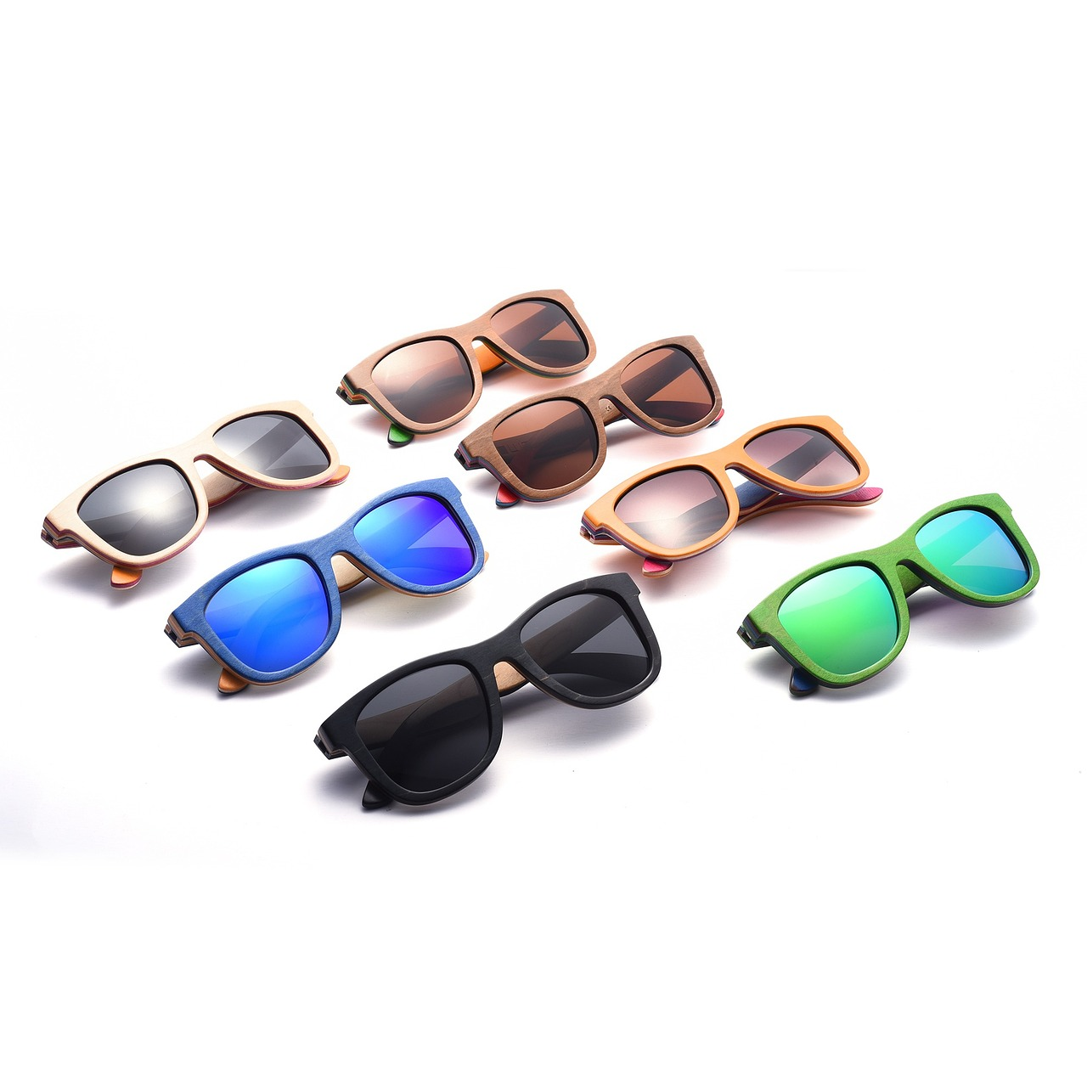
Become a ‘frame collector’

Slide 8
Become a ‘frame collector’
Frame:
“a set of ideas or facts that a person accepts and that influences the person's behavior, opinions, or decisions”
(Cambridge Dictionary)
Examples of frames:
Personality (Big Five)
Behavioural preferences
Demographics
Identity
Action logic
Geography
Culture (broadly defined)
→ Lived experience

Slide 9
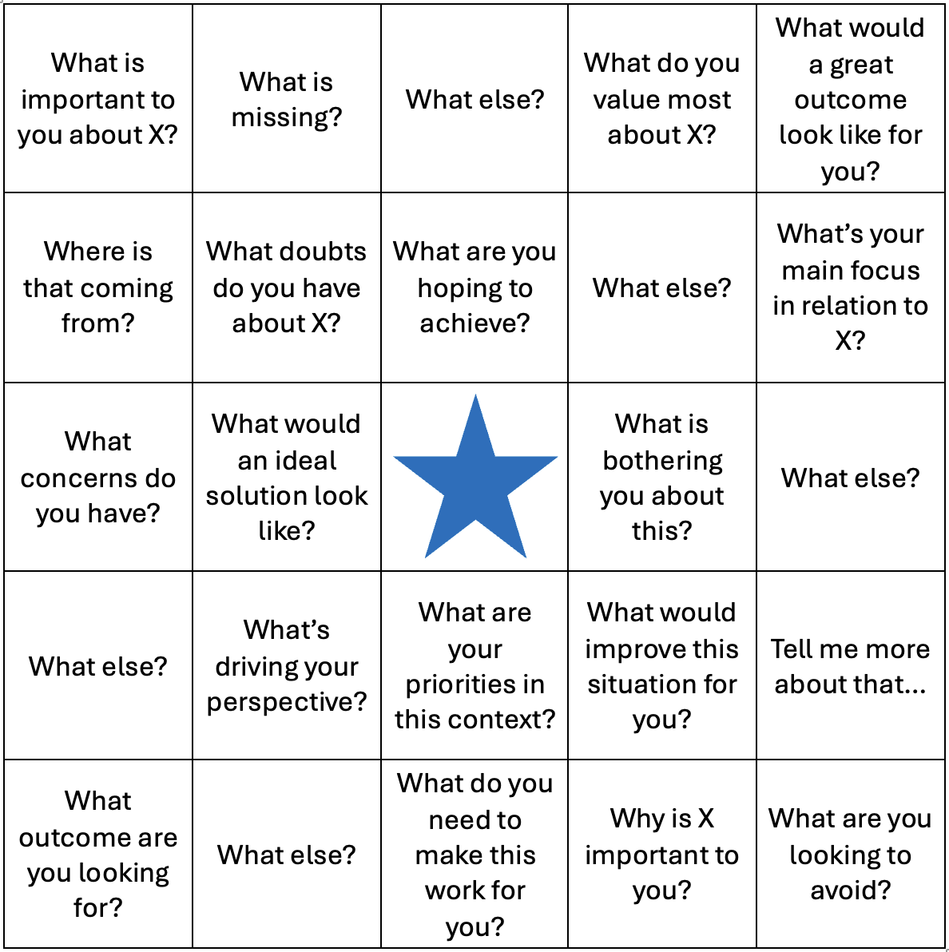
Digging deeper

Slide 10
#2: Perspective-sharing
Being: Self-worth
Generosity
Service
Seeing: “How can I add value?”
Doing: Explaining your perspective, sharing your:
Data (observations, evidence)
Interpretation (assumptions, thinking)
Conclusion (proposed action)
Declare your biases

Slide 11

Show your work

Slide 12
Show your work
YOURS
THEIRS
CONCLUSION
decision, opinion
→ action
ADVOCACY
Share your perspective starting from the bottom of the ladder and working your way up, checking in to seek alignment with them on each rung
ENQUIRY
Learn more about their perspective by asking open questions starting from the top of the ladder and working your way down
INTERPRETATION
meaning, assumptions, reasoning
DATA
facts, observations
Ref: Ladder of Inference, Chris Argyris, Action Design

Slide 13
#3: Perspective-integrating
Being: Optimism
Creativity
Adaptability
Seeing: “How might we ‘expand the pie’?”
“How might we address the tension between our different perspectives?”
Doing: Make low-cost, high-value trades to create mutual value (Harvard Negotiation Project)
Integrate polarities (Barry Johnson)

Slide 14

Find the balance in ‘both/and’

Slide 15

Look for the ‘both/and’
Benefits
Benefits
What actions will enable us to gain the benefits of this pole?
What actions will enable us to gain the benefits of this pole?
Downsides of overuse
Downsides of overuse
What early warning signs will alert us to the overuse of this pole?
What early warning signs will alert us to the overuse of this pole?
Ref: And by Barry Johnson PhD

Slide 16
Find the balance in ‘both/and’ (example)
Benefits
Benefits
What actions will enable us to gain the benefits of Stability?
What actions will enable us to gain the benefits of Change?
Stability
Change
Downsides of overuse
Downsides of overuse
What early warning signs will alert us to the overuse of Stability?
What early warning signs will alert us to the overuse of Change?
Ref: And by Barry Johnson PhD

Slide 17
From Influence to Confluence
“Apart from the substantive merits, the feeling of participation in the process is perhaps the single most important factor in determining whether a negotiator accepts a proposal.”
Ref: Getting to Yes by Fisher, Ury & Patton

Slide 18
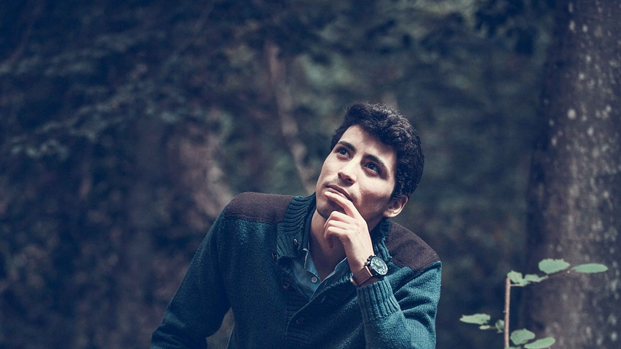
Create a ‘Thinking Environment’

Slide 19
Creating a ‘Thinking Environment’
1. Attention | Minimise distractions, listen deeply, demonstrate interest, avoid interrupting
2. Equality | Treat others as equals, give them equal time to think and speak, monitor ‘airtime distribution’
3. Ease | Relax, let go of impatience
4. Appreciation | Tell people what you appreciate and them and their contribution
5. Feelings | Allow space for emotions to arise and be shared
6. Encouragement | Support others to explore the edge of their thinking (it’s not a competition)
7. Information | Take time to absorb the relevant data
8. Difference | Create space for people to express different perspectives, experiences and identities
9. Incisive Questions | Ask questions to explore hidden assumptions
10. Place | Consider how the physical environment enhances comfort and respect for others
Ref: Time to Think by Nancy Kline (https://www.timetothink.com/thinking-environment/)

Slide 20
Questions

